Slide 1
EFSA Art.36 GRANT Standard Application Form
PROPOSED TITLE:
Enhancing Food Safety Through Advanced Microbiological Monitoring
All events and references in this document are fictional and to be used for training purposes only

Slide 2
Standard Application Form
Tittle
Beneficiary
Period of implementation
Background of the proposal
Main objectives
Estimated budget
Expected results
Staff: | Name | Role
All events and references in this document are fictional and to be used for training purposes only

Slide 3
Standard Application Form
Tittle | Enhancing Food Safety Through Advanced Microbiological Monitoring
Beneficiary | Risk Assessment Center on Food Chain
Duration | 12 Months
Background of the proposal
Food safety is a top concern for everyone. Food consumption is not always safe. If the food is not safe people can get sick. Health and budget problems can occurred. To make sure food is safe to eat, we need good rules and methods to check it.
Scientists have found better ways to study tiny living things, like bacteria, viruses, and fungi, that can make food unsafe. These little things can get into our food when it's being made, processed, shipped, or stored. They can make us sick or spoil the food, causing big money losses. There is a need for the scientists in our institution to be trained in implementation of advanced tools and methods.
The project idea focuses on two main aspects:
1.Emerging Food Safety Challenges: The food industry faces challenges due to globalization, changes in food production practices, and climate-related issues. These challenges have led to the emergence of new pathogens and contaminants that demand advanced monitoring techniques. To protect people, we need better tools to keep an eye on these new problems.
2.Traditional Methods vs. Advanced Monitoring: Conventional microbiological monitoring methods, have limitations in terms of speed, sensitivity, and the ability to detect specific contaminants. We will implement new advanced techniques (genomics and metagenomics) and real-time checks that can make food safety much better by findings into foodborne pathogens and spoilage microorganisms faster and more accurately
All events and references in this document are fictional and to be used for training purposes only

Slide 4
Standard Application Form
Enhancing Food Safety Through Advanced Microbiological Monitoring
Main objectives
1. Implement Advanced Microbiological Monitoring Techniques: The primary objective is to implement advanced microbiological monitoring techniques that can provide more rapid and accurate detection and identification of foodborne pathogens and spoilage microorganisms.
2. Enhance Early Contaminant Detection: Improve the early detection of contaminants in the food chain, from farm to fork, by applying cutting-edge microbiological and genomic technologies to reduce the risk of foodborne illness outbreaks and economic losses.
3. Provide Educational and Training Courses to Staff: Establish educational and training resources to disseminate knowledge and techniques implemented during the project to benefit the broader scientific community, food industry, and regulatory bodies.
These objectives reflect the project's mission to advance food safety through innovative microbiological monitoring, with a focus on early detection, compliance with regulations, and the broader impact on global food safety. Achieving these objectives would have far-reaching implications for both public health and the food industry.
All events and references in this document are fictional and to be used for training purposes only

Slide 5
Standard Application Form
Enhancing Food Safety Through Advanced Microbiological Monitoring
Expected Results
1. Implemented Advanced Microbiological Monitoring Techniques: the project is expected to implement advanced microbiological monitoring techniques that provide improved speed, sensitivity, and specificity in detecting foodborne pathogens and spoilage microorganisms.
2. Early Detection and Mitigation: with the implementation of advanced monitoring techniques, the research project anticipates early detection of contaminants at various stages of the food chain, enabling measures to prevent foodborne outbreaks and product spoilage.
3. Educational Resources and Training: the project will result in educational and training resources for scientists, and regulatory bodies to disseminate the knowledge and techniques developed during the research.
4. Scientific Advancements: the research project is expected to contribute to raise the expertise and knowledge in the national laboratories, better quality of produced data and more accurate and more detailed risk assessment.
All events and references in this document are fictional and to be used for training purposes only

Slide 6
Standard Application Form
Enhancing Food Safety Through Advanced Microbiological Monitoring
Staff: | Name | Role
Manager
Coordinator
Researcher
Administrative
All events and references in this document are fictional and to be used for training purposes only

Slide 7
Standard Application Form
Enhancing Food Safety Through Advanced Microbiological Monitoring
Select a period to highlight at right. A legend describing the charting follows. |  |  |  |  | Period Highlight: | 12 |  |  | Plan Duration |  |  |  |  |  | Actual Start
Activity | Start | Duration | Actual start | Actual duration | Progress | Moths
 |  |  |  |  |  | 1 | 2 | 3 | 4 | 5 | 6 | 7 | 8 | 9 | 10 | 11 | 12
Research and preparation of equipment purchase | 1 | 2 | 1 | 4 | 100%
Research and plan for implementing purchased equipment | 1 | 4 | 1 | 4 | 80%
Training of the experts | 4 | 3 | 2 | 4 | 10%
Data collection | 3 | 3 | 5 | 1 | 30%
Laboratory tests performing | 5 | 4 | 1 | 12 | 0%
Confirmation of the results | 7 | 3 | 5 | 12 | 0%
Implementing protocols and methodology | 5 | 5 | 6 | 1 | 0%
Add the method and protocols at National legalization for microbiological monitoring from the next year | 6 | 4 | 5 | 3 | 0%
Final workshop | 11 | 1 | 9 | 3 | 0%
Final report | 11 | 2 | 10 | 3 | 0%
All events and references in this document are fictional and to be used for training purposes only

Slide 8
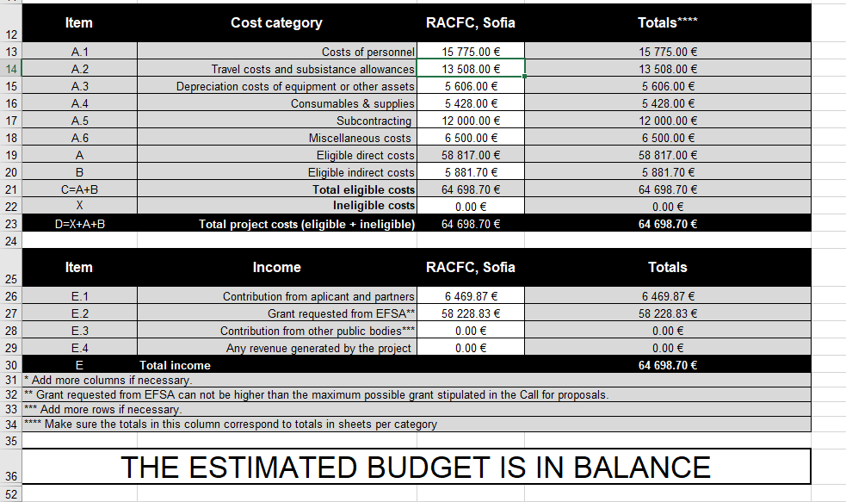
Standard Application Form
Enhancing Food Safety Through Advanced Microbiological Monitoring
Estimated budget 100 000 €
20 – 25 %
65 -70 %
5 – 10 %
All events and references in this document are fictional and to be used for training purposes only

Slide 9
Standard Application Form
Enhancing Food Safety Through Advanced Microbiological Monitoring
Timesheet example
Participant: |  |  |  | Month: | June
Institution: | Risk Assessment Center on Food Chain |  | Projectт:
Unit/Department
Timesheet 1
Date | Cat. ² | Task Deskription³ |  |  |  | Hours
 |  | Purchasing equipment |  |  |  | 1
 |  | Preparation of trainings |  |  |  | 1
 |  | Preparation of trainings |  |  |  | 1
 |  | Purchasing equipment |  |  |  | 1
 |  | Preparation of trainings |  |  |  | 1
 |  | Installing equipment |  |  |  | 1
 |  | Module1 of training preparation |  |  |  | 4
 |  | Module1 of training preparation |  |  |  | 4
 |  | Module1 of training preparation |  |  |  | 4
 |  | Test of Software |  |  |  | 1
 |  | Module1 of training |  |  |  | 4
 |  | Module1 of training |  |  |  | 4
 |  | Module1 of training |  |  |  | 2
 |  | Intermediate report preparation |  |  |  | 4
 |  | Test of software and updating business rules |  |  |  | 2
All events and references in this document are fictional and to be used for training purposes only

Slide 10
Standard Application Form
Enhancing Food Safety Through Advanced Microbiological Monitoring
Timesheet example
 |  |  | Aggregation of taken samples and preparation of tasks for Module2 |  |  |  |  |  | 1
 |  |  | Communication with trainees about sampling preparation for Module 2 of training |  |  |  |  |  | 1
 |  |  |  |  |  |  | Total of hours per month: |  | 56
 |  |  |  |  |  |  | Total days per mont: |  | 7
Staffmembers's signature+date |  |  |  |  |  | Signiture of the manager/supervisor
 |  |  |  |  |  | + name, function and date
(1) Use 1 line per day per task category |  |  |  |  |  |  |  | Timesheet version 1.0
(2) Choose 1/2/3/4 (1=administrative, 2=scientific, 3=meetings and workshops)
(3) Provide a detailed and exact description of the tasks carried out
All events and references in this document are fictional and to be used for training purposes only

Slide 11
Thank you
All events and references in this document are fictional and to be used for training purposes only

